Slide 1


Intelligence
runs deeper.
A private AI workspace in development
Product brief / October 2026
Notes:
Undergrove is an early product concept with an implemented brand, website, and scripted interface. This deck describes the product direction and the evidence needed for a live service.
Sources
Undergrove working strategy, 19 October 2026: docs/POSITIONING.md
Undergrove delivery plan, 19 October 2026: docs/PRODUCT-ROADMAP.md
Original generated brand artwork: kit/02-artwork/forest-hero.png. This image is not documentary evidence.

Slide 2


The first audience
Independent builders
and researchers
People who use AI for ongoing work and want
to control the context they share.
STARTING HYPOTHESIS
A useful workspace should help them finish the task
and understand where their information goes.
UNDERGROVE
02
Notes:
Audience hypothesis, not measured demand. Validate the proposed focus through task-based interviews before extending the product to broader segments. No market size, customer count, or traction claim is implied.
Sources
Undergrove working strategy, 19 October 2026: docs/POSITIONING.md
Undergrove delivery plan, 19 October 2026: docs/PRODUCT-ROADMAP.md

Slide 3
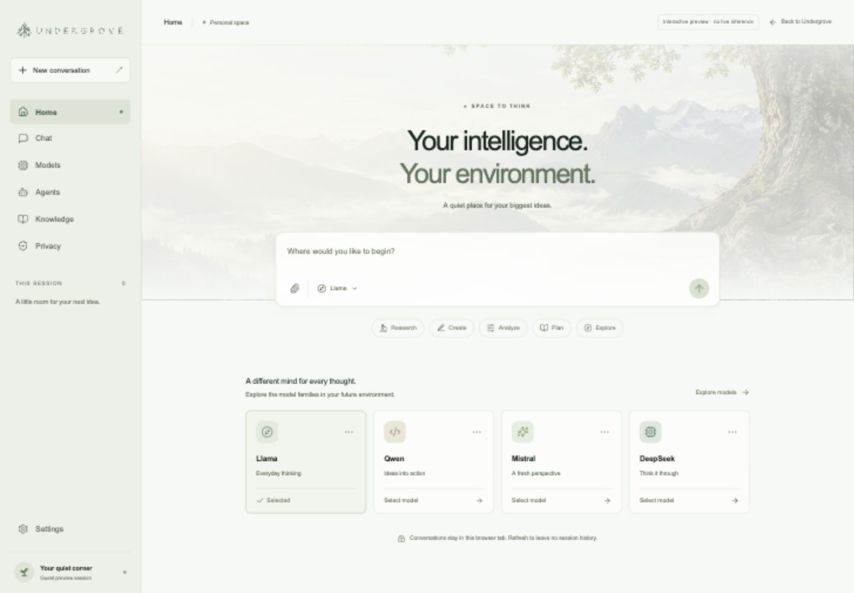
A workspace for sustained work
Conversation
Prompts, model selection
and session history in
one considered interface.
Personal knowledge
Planned retrieval and
optional memory, with
export and deletion controls.
Current interface preview. Responses are scripted.
UNDERGROVE
03
Notes:
The image shows the implemented Undergrove interface preview. It contains no live inference. Document handling currently reads metadata only. Retrieval, persistent memory, export, and deletion are planned service capabilities.
Sources
Undergrove working strategy, 19 October 2026: docs/POSITIONING.md
Undergrove delivery plan, 19 October 2026: docs/PRODUCT-ROADMAP.md
Actual product preview screenshot: kit/07-website/workspace-desktop.jpg

Slide 4

What exists today
Built
Next to prove
Brand system and cinematic website
Live inference and authentication
Responsive workspace
Storage, retrieval and deletion
Scripted conversations in tab memory
Retention and access controls
File names, sizes and types only
Costs, capacity and support
The preview does not run a model or store user accounts.
UNDERGROVE
04
Notes:
Current state verified from the source implementation. Conversations are held in component memory. File inputs collect names, sizes, and types without reading file contents. No authentication, inference provider, account database, or billing service is connected.
Sources
Undergrove working strategy, 19 October 2026: docs/POSITIONING.md
Undergrove delivery plan, 19 October 2026: docs/PRODUCT-ROADMAP.md
Source implementation: src/pages/Workspace.jsx

Slide 5
Proposed alpha data flow
One licensed open-weight model on a declared hosting route.
Planned transport protection
Browser
Gateway
Model worker
Conversation interface
Identity and usage limits
Declared GPU infrastructure
Plaintext boundary
Evidence before launch
The gateway and worker can process content
in this first design.
A data inventory, retention tests and
clear disclosures for each model route.
UNDERGROVE
05
Notes:
Proposed architecture, not an implemented service. The initial recommendation is an operated licensed open-weight model, not a newly trained foundation model. Transport encryption alone does not prevent operators from accessing plaintext. Hardware confidentiality and client-to-enclave encryption require separate design and verification.
Sources
Undergrove working strategy, 19 October 2026: docs/POSITIONING.md
Undergrove delivery plan, 19 October 2026: docs/PRODUCT-ROADMAP.md

Slide 6
Our proposed position
Venice
Undergrove
PUBLISHED OFFERING
PRODUCT DIRECTION
Model-dependent privacy modes
A focused environment
for sustained work
Anonymous
Private
TEE
E2EE
User-controlled knowledge
Clear data choices for each model
Portable conversations
Venice's published documentation, checked 19 October 2026. Provider claims are not an independent audit.
UNDERGROVE
06
Notes:
Venice describes four modes named Anonymous, Private, TEE, and E2EE, with different provider access, retention, and confidentiality boundaries. This summary does not independently verify those claims. Undergrove attributes are product proposals. The comparison does not claim that Venice lacks these workflow features.
Sources
Undergrove working strategy, 19 October 2026: docs/POSITIONING.md
Undergrove delivery plan, 19 October 2026: docs/PRODUCT-ROADMAP.md
Venice privacy architecture, accessed 19 October 2026: https://venice.ai/privacy

Slide 7
Release gates
Proposed sequence for the first live service.
01
02
03
Private alpha
Personal workspace
Paid beta
One model and one
hosting route
Context that users control
A service people can rely on
Measured quality and latency.
A tested retention policy.
Permission-scoped retrieval.
Reliable export and deletion.
Real task costs and capacity.
Account recovery and support.
Additional model routes, tools and confidential computing follow separate reviews.
UNDERGROVE
07
Notes:
These are release gates, not promised delivery dates. The working roadmap places additional model routes, agents and dedicated options after a stable paid beta. Verifiable confidentiality requires a threat model, attestation and key-lifecycle review, followed by external assessment.
Sources
Undergrove working strategy, 19 October 2026: docs/POSITIONING.md
Undergrove delivery plan, 19 October 2026: docs/PRODUCT-ROADMAP.md

Slide 8
What the alpha needs to prove
Usefulness
Can people complete meaningful tasks and return?
Understanding
Can they explain where a chosen model sends data?
Economics
What does a completed task cost to serve?
Reliability
Do failures, access checks and deletion behave correctly?
Pricing follows observed usage and measured cost. Demand still needs validation.
UNDERGROVE
08
Notes:
Validation agenda only. No user count, retention rate, cost forecast, benchmark result, revenue, or pricing is asserted. Useful metrics include task completion, repeat use, privacy comprehension, latency, failure rate, and cost per completed task. Avoid collecting conversation content merely to calculate these metrics.
Sources
Undergrove working strategy, 19 October 2026: docs/POSITIONING.md
Undergrove delivery plan, 19 October 2026: docs/PRODUCT-ROADMAP.md

Slide 9
The next milestone
A private alpha people
can use and understand
The preview makes the experience tangible.
The next release must prove the service behind it.
UNDERGROVE
09
Notes:
Next milestone proposed for discussion: a live alpha with one evaluated licensed model, a declared hosting route, and published data-handling boundaries. No launch date, team composition, funding ask, token plan, or promised return is included.
Sources
Undergrove working strategy, 19 October 2026: docs/POSITIONING.md
Undergrove delivery plan, 19 October 2026: docs/PRODUCT-ROADMAP.md
Original generated brand artwork: kit/02-artwork/forest-hero.png. This image is not documentary evidence.

